Slide 1
Employee Data Analysis using Excel
STUDENT NAME:CHERAN.S
REGISTER NO:312211594
NM ID. :013C5AA2E923AD8BA244C62BEB20D4E2
DEPARTMENT: COMMERCE GENERAL
COLLEGE: THIRUTHANGAL NADAR COLLEGE

Slide 2
PROJECT TITLE
VISUALISING EMPLOYEE ATTENDANCE TRENDS WITH EXCEL CHARTS

Slide 3


AGENDA
Problem Statement
Project Overview
End Users
Our Solution and Proposition
Dataset Description
Modelling Approach
Results and Discussion
Conclusion
3/21/2024 Annual Review

Slide 4

PROBLEM STATEMENT
Objective: To develop an effective system for tracking and visualizing employee attendance data using Excel charts, enabling HR managers and team leaders to identify attendance patterns, manage workforce availability, and make informed decisions.Context: Managing employee attendance is crucial for organizational productivity and planning. However, with large teams, it can be challenging to identify trends, such as frequent absences, tardiness, or periods of high or low attendance. Current methods of tracking attendance might involve basic spreadsheets or attendance logs, which provide raw data but lack the visualization needed for quick analysis and decision-making.

Slide 5

PROJECT OVERVIEW
Project Title:
Visualizing Employee Attendance Trends Using Excel Charts
Project Duration:
3-4 weeks (depending on data complexity and chart requirements)

Slide 6

WHO ARE THE END USERS?
1. HR Managers and HR Team
2. Department Managers and Team Leaders
3. Senior Management and Executives
4. Payroll and Finance Teams
5. IT and Data Analysts
6. Employees (Indirectly)

Slide 7

OUR SOLUTION AND ITS VALUE PROPOSITION
Chart Type:The chart is a horizontal bar chart, not a histogram. A histogram typically shows the distribution of numerical data by dividing it into bins, whereas a bar chart compares different categories.Categories on the Y-axis:The Y-axis lists individual names ("Aldo," "Aleena," "Alejandro," etc.) along with a "Total" category for each (e.g., "Aldo Total," "Aleena Total," "Alejandro Total"). These are likely employees or groups whose attendance data or another metric is being compared.Values on the X-axis:The X-axis represents numerical values, likely corresponding to a specific metric such as total hours, attendance counts, or other related data. The scale ranges from 0 to 4000, but the exact unit isn’t specified in the image.Bars and Data Points:Horizontal bars extend from the Y-axis categories. The length of each bar corresponds to the value on the X-axis. For instance, the bar associated with "Alejandro" extends further than the bar for "Aldo," indicating a higher value for whatever metric is being measured.Data Labels:Some bars have data labels (e.g., "Dyer," "Stephens," "David," etc.). These labels may represent additional categories, names, or segments within each bar, but it’s not clear from the image what exactly they denote. They seem to be associated with specific bars, possibly showing the leading contributor or key segment within each bar.Legend:The legend on the right side uses colored boxes (blue, red, yellow) to indicate different categories, labels, or data series. The specific meanings of the colors aren't shown in the image, but they are likely used to distinguish different groups or types of data within the chart.

Slide 8
Dataset Description
Employee ID:Description: A unique identifier for each employee.Type: Alphanumeric or numeric.Example: E001, E002, 1001.Employee Name:Description: The full name of the employee.Type: Text.Example: John Doe, Jane Smith.Department:Description: The department in which the employee works.Type: Text.Example: Sales, Human Resources, IT.Date:Description: The date of the attendance record.Type: Date.Example: 2024-08-30, 2024-09-01.Check-In Time:Description: The time when the employee checked in.
Check-Out Time:Description: The time when the employee checked out.Type: Time.Example: 05:30 PM, 06:00 PM.Hours Worked:Description: The total number of hours the employee worked that day.Type: Numeric (decimal).Example: 8.0, 7.5.Attendance Status:Description: Indicates whether the employee was present, absent, on leave, etc.Type: Categorical (text).Example: Present, Absent, Sick Leave, Vacation.Overtime Hours:Description: The number of hours worked beyond the standard working hours.Type: Numeric (decimal).Example: 2.0, 0.0.Absence Reason:Description: The reason for the employee’s absence, if applicable.Type: Text.Example: Sick, Personal, Vacation.

Slide 9

THE "WOW" IN OUR SOLUTION
The histogram seems to be showing a comparison between specific employees and their total contributions in a certain metric (e.g., hours worked, performance, or tasks).
You can observe that employees such as Aldo, Aleena, and Alejandro have corresponding total values, which might help in understanding their overall contributions over a period.
3/21/2024 Annual Review
‹#›

Slide 10
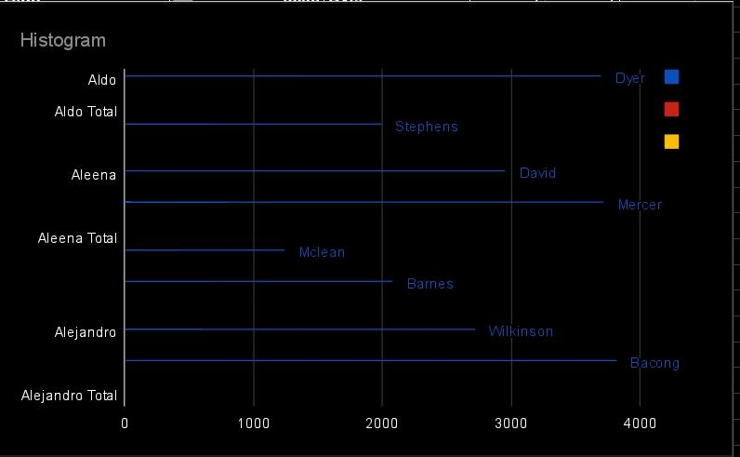
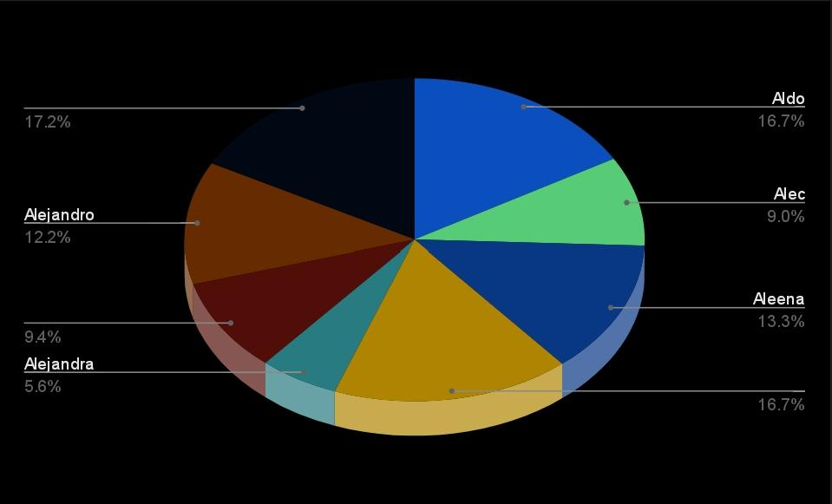
MODELLING
‹#›

Slide 11
RESULTS
This pie chart provides a visual representation of data, likely indicating the distribution of some quantity (e.g., hours worked, tasks completed, percentage contribution) among different employees. Here’s what it shows:Slices of the Pie: Each slice represents a specific employee (Aldo, Aleena, Alejandro, etc.).Percentage Labels: Display the proportion of the total each employee contributes. For example:Aldo: 16.7%Aleena: 13.3%Alejandro: 12.2%The largest slice (17.2%) might represent a cumulative category or an employee not explicitly named on the chart.
‹#›

Slide 12
conclusion
Both charts likely represent the same dataset, but in different visual formats—histogram and pie chart. They show the breakdown of some metric (such as tasks, quantities, or resources) among different individuals, with Aldo, Aleena, and Alejandro being prominent figures in the data.

Slide 13
